Slide 1

Two-Day Dyadic data analysis Workshop
Randi L. Garcia
Smith College
UCSF January 9th and 10th
 @RandiLGarcia  RandiLGarcia

Slide 2
Day 1
Definitions and Nonindependence
Data Structures
The Actor-Partner Interdependence Model (APIM)
Generalized Mixed Modeling (i.e., small counts and binary outcomes)

Slide 3
Definitions: Distinguishability
Can all dyad members be distinguished from one another based on a meaningful factor?
Distinguishable dyads
Gender in heterosexual couples
Patient and caregiver
Race in mixed race dyads
When a systematic ordering of scores from the two dyad members can be developed based on a variable that distinguishes them.

Slide 4
All or Nothing
If most dyad members can be distinguished by a variable (e.g., gender), but a few cannot, then can we say that the dyad members are distinguishable?
No, we cannot!
4

Slide 5
Indistinguishability
There is no systematic or meaningful way to order the two scores
Examples of indistinguishable dyads
Same-sex couples
Twins
Same-gender friends
Mix of same-sex and heterosexual couples
When all dyads are hetero except for even one couple!

Slide 6
It can be complicated…
Distinguishability is a mix of theoretical and empirical considerations.
For dyads to be considered distinguishable:
It should be theoretically important to make such a distinction between members.
Also it should be shown that empirically there are differences.
Sometimes there can be two variables that can be used to distinguish dyad members: Spouse vs. patient; husband vs. wife.
6

Slide 7
Types of Variables
Between Dyads
Variable varies from dyad to dyad, BUT within each dyad all individuals have the same score
Length of relationship
Gender in same-sex couples
Called a level 2, or macro variable in multilevel modeling

Slide 8
A
A
A
B
A
B
B
A
A
B
Between

Slide 9
Within Dyads
Variable varies from person to person within a dyad, BUT there is no variation on the dyad average from dyad to dyad.
Gender in heterosexual couples
Percent time talking in a dyad
Reward allocation if each dyad is assigned the same total amount
X1 + X2 equals the same value for each dyad
Note: If in the data, there is a dichotomous within-dyads variable, then dyad members can be distinguished on that variable.

Slide 10
B
B
A
B
A
B
A
B
A
A
Within

Slide 11
Within Dyads
Variable varies from person to person within a dyad, BUT there is no variation on the dyad average from dyad to dyad.
Gender in heterosexual couples
Percent time talking in a dyad
Reward allocation if each dyad is assigned the same total amount
X1 + X2 equals the same value for each dyad
Note: If in the data, there is a dichotomous within-dyads variable, then dyad members can be distinguished on that variable.

Slide 12
Mixed Variable
Variable varies both between dyads and within dyads.
In a given dyad, the two members may differ in their scores, and there is variation across dyads in the average score.
Age in married couples
Gender (if both same-sex and heterosexual couples are included in the study)
Lots-o personality variables
Most outcome variables are mixed variables.

Slide 13
It can be complicated…
The same conceptual variable can be between-dyads, within-dyads, or mixed.
Gender
Between: Same gendered roommates
Within: Heterosexual married couples
Mixed: Friends where some are same gendered and others are mixed gendered.
13

Slide 14
Types of Dyadic Designs
14

Slide 15
Standard Dyadic Design
Each person has one and only one partner.
About 75% of research with standard dyadic design
Examples: Dating couples, married couples, friends
15

Slide 16
Standard Design-Indistinguishable
16

Slide 17
Standard Design - Distinguishable
17

Slide 18
The One-with-Many Design
All partners have the same role with the focal person
For example, students with teachers or workers with managers
18
Notes:
18
This is the more general case – when partners are interchangeable. E.g., doctor-patient, manager-workers, teacher-students, leader-followers)

Slide 19
Round-Robin Design
Social Relations Model (SRM)
Examples: Team or family members rating one another
19
Notes:
19

Slide 20
Data Structures

Slide 21
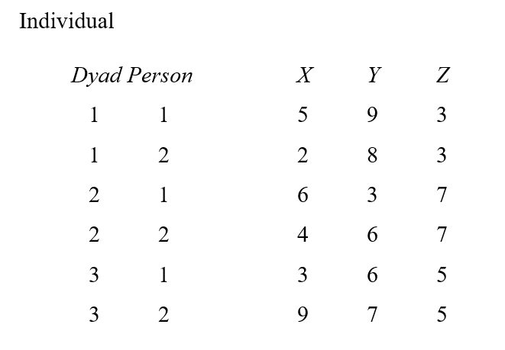
Illustration of Data Structures
Data Set with Three Dyads, Six Persons, and Three Variables (X, Y, and Z)

Slide 22
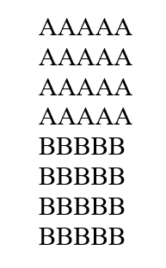
Illustration of Data Structures
Note if the individual dataset is sorted by person then dyad it looks like this:

Slide 23
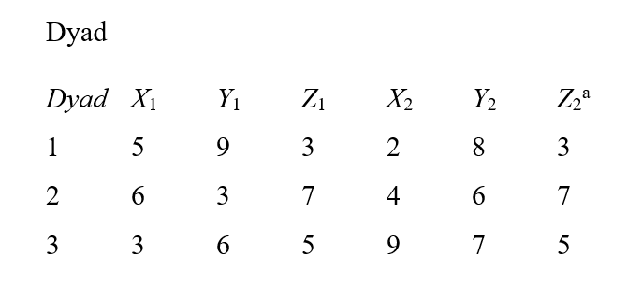
Illustration of Data Structures

Slide 24
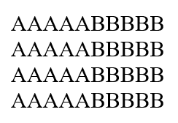
Illustration of Data Structures: Dyad

Slide 25
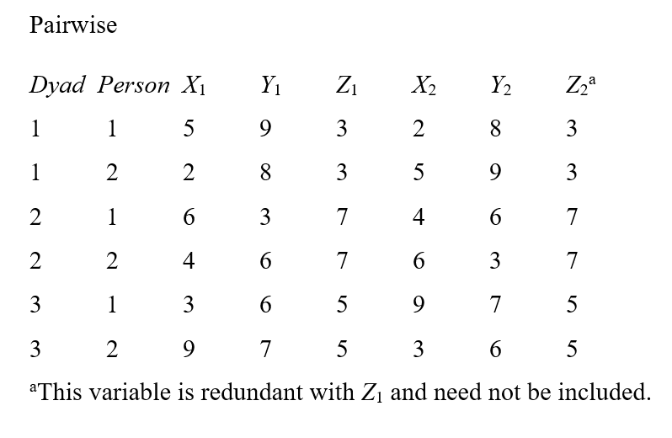
Illustration of Data Structures

Slide 26
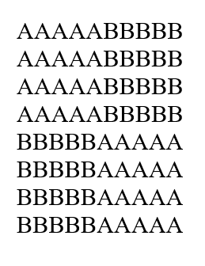
Illustration of Data Structures: Pairwise

Slide 27
R Demo & Dave’s Shiny Apps

Slide 28
Dealing with Nonindependence in DYads

Slide 29
Negative Nonindependence
Nonindependence is often defined as the proportion of variance explained by the dyad.
BUT, nonindependence can be negative…variance cannot!
This is super important
THE MOST IMPORTANT THING ABOUT DYADS!

Slide 30
How Might Negative Correlations Arise?
Compensation: If one person has a large score, the other person lowers his or her score. For example, if one person acts very friendly, the partner may distance him or herself.
Social comparison: The members of the dyad use the relative difference on some measure to determine some other variable. For instance, satisfaction after a tennis match is determined by the score of that match.

Slide 31
How Might Negative Correlations Arise?
Division of labor: Dyad members assign one member to do one task and the other member to do another. For instance, the amount of housework done in the household may be negatively correlated.
Power: If one member is dominant, the other member is submissive. For example, self-objectification is negatively correlated in dyadic interactions.

Slide 32
Effect of Nonindependence
Effect Estimates Unbiased
Standard Errors Biased
Sometimes too large
Sometimes too small
Sometimes hardly biased
Loss of Degrees of Freedom

Slide 33
Direction of Bias Depends on
Direction of Nonindependence
Positive: linked scores more similar
Negative: linked scores more dissimilar
Is the predictor a between or within dyads variable? (or somewhere in between, mixed)
Between Dyads: linked scores in the same condition
Within Dyads: linked scores in different conditions

Slide 34
Effect of Ignoring Nonindependence on Significance Tests

Slide 35
What Not To Do!
Ignore it and treat individual as unit
Discard the data from one dyad member and analyze only one members’ data
Collect data from only one dyad member to avoid the problem
Treat the data as if they were from two samples (e.g., doing an analysis for husbands and a separate one for wives)
Presumes differences between genders (or whatever the distinguishing variable is)
Loss of power

Slide 36
What To Do
Consider both individual and dyad in one analysis!
Multilevel Modeling
Structural Equation Modeling

Slide 37
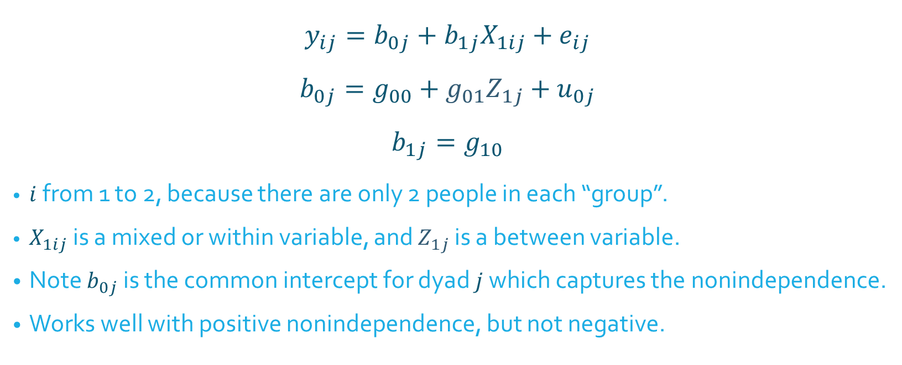
Traditional Model: Random Intercepts
$$y_{ij}=b_{0j}+b_{1j}X_{1ij}+e_{ij}$$
$$b_{0j}=g_{00}+g_{01}Z_{1j}+u_{0j}$$
$$b_{1j}=g_{10}$$
$i$ from 1 to 2, because there are only 2 people in each “group”.
$X_{1ij}$ is a mixed or within variable, and $Z_{1j}$ is a between variable.
Note $b_{0j}$ is the common intercept for dyad $j$ which captures the nonindependence.
Works well with positive nonindependence, but not negative.
Micro level
Macro level

Slide 38

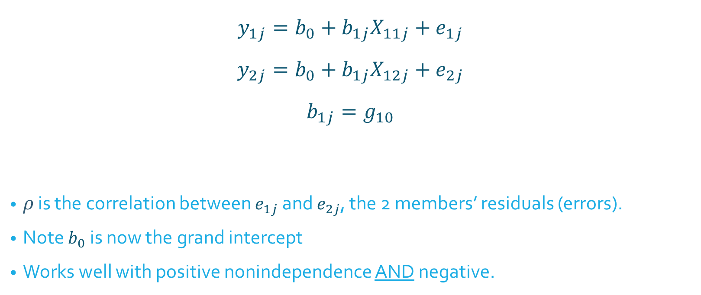
Alternative Model: Correlated Errors
$$y_{1j}=b_{0}+b_{1j}X_{11j}+e_{1j}$$
$$y_{2j}=b_{0}+b_{1j}X_{12j}+e_{2j}$$
$$b_{1j}=g_{10}$$
$ρ$ is the correlation between $e_{1j}$ and $e_{2j}$, the 2 members’ residuals (errors).
Note $b_{0}$ is now the grand intercept
Works well with positive nonindependence AND negative.
$ρ$ called “rho”
Micro level
Macro level

Slide 39
MLM for dyadic data

Slide 40
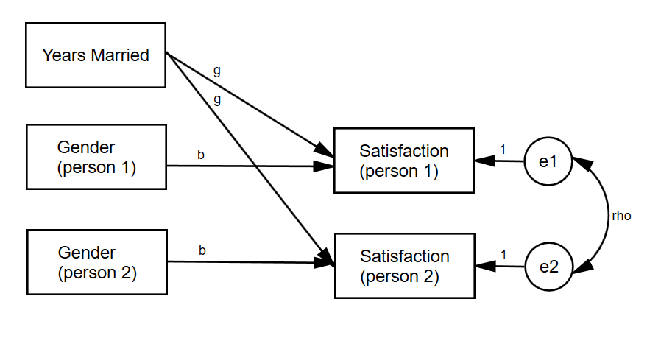
Simple Example
Years married (Z) and gender (X) predicting marital satisfaction

Slide 41
R Demo

Slide 42
Actor-Partner Interdependence Model (APIM)

Slide 43
Actor-Partner Interdependence Model (APIM)
A model that simultaneously estimates the effect of a person’s own variable (actor effect) and the effect of same variable but from the partner (partner effect) on an outcome variable
The actor and partner variables are the same variable from different persons.
All individuals are treated as actors and partners.
Example
Dyads, one a patient with a serious disease and other being the patient’s spouse
Interested in the effects of depression on relationship quality

Slide 44
Data Requirements
Two variables, X and Y, and X causes or predicts Y
Both X and Y are mixed variables; i.e., both members of the dyad have scores on X and Y.

Slide 45
Actor Effect
Definition: The effect of a person’s X variable on that person’s Y variable
the effect of patients’ depression on patients’ quality of life
the effect of spouses’ depression on spouses’ quality of life
Both members of the dyad have an actor effect.

Slide 46
Partner Effect
Definition: The effect of a person’s partner’s X variable on the person’s Y variable or alternatively the effect of a person’s X variable on his or her partner’s Y variable
the effect of patients’ depression on spouses’ quality of life
the effect of spouses’ depression on patients’ quality of life
Both members of the dyad have a partner effect.

Slide 47
Distinguishability and the APIM
Distinguishable dyads
Two actor effects
An actor effect for patients and an actor effect for spouses
Two partner effects
A partner effect from spouses to patients and a partner effect from patients to spouses

Slide 48
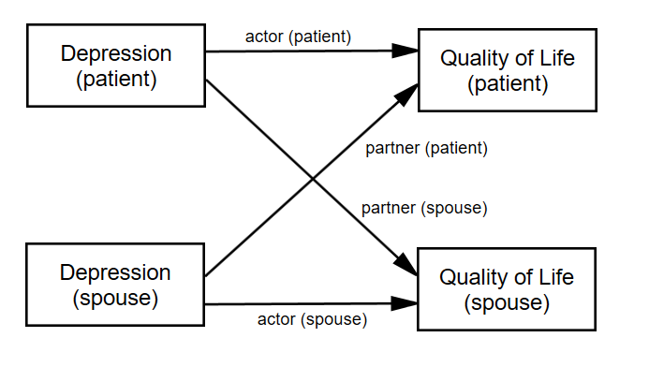
Distinguishable Dyads
Errors not pictured (but important)
The partner effect is fundamentally dyadic. A common convention is to refer to it by the outcome variable. Researcher should be clear!

Slide 49
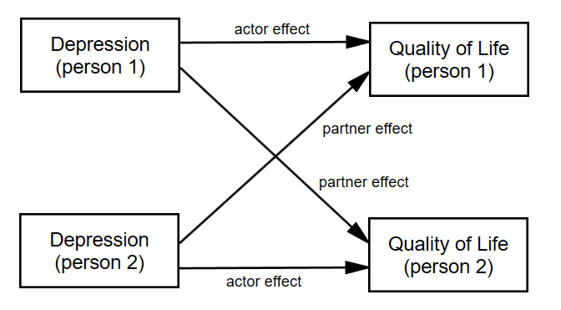
Indistinguishable Dyads
The two actor effects are set to be equal and the two partner effects are set to be equal.

Slide 50
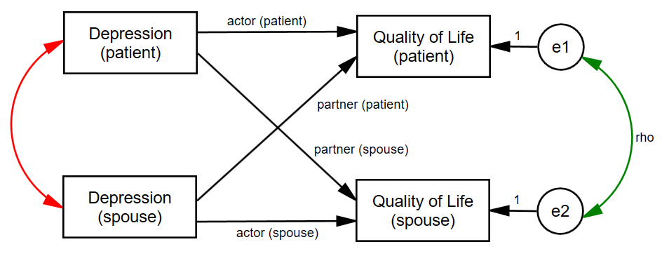
Nonindependence in the APIM
Green curved line: Nonindependence in Y
Red curved line: X as a mixed variable (r cannot be 1 or -1)
Note that the combination of actor and partner effects explain some of the nonindependence in the dyad.

Slide 51
Types of APIM Models
Personality Model
Relationship Variables
Accuracy-Bias Model
Stability-Influence Model

Slide 52
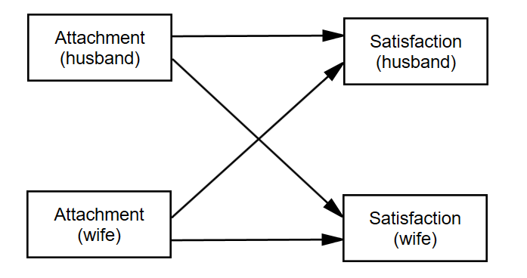
Personality Model
Actor effects measure the effect of own personality on satisfaction.
Partner effects measure the effect of partner’s personality on satisfaction.

Slide 53
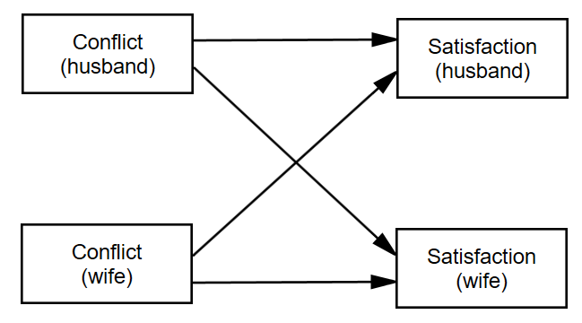
Relational Model
Actor effects measure the effect of one’s own relational variable to one’s own other relational variable.
Partner effects measure the effect of one’s partner’s relational variable on one’s own relational variable.

Slide 54
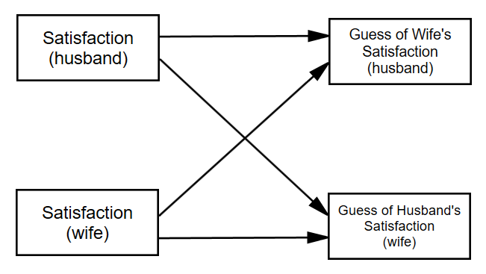
Accuracy-Bias Model
Actor effects measure the bias of assumed similarity.
Partner effects measure accuracy in perception.

Slide 55
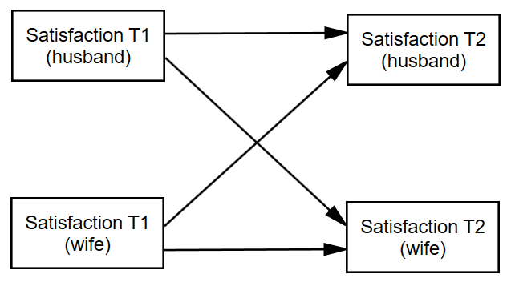
Stability-Influence Model
Actor effects measure stability.
Partner effects measure influence.

Slide 56
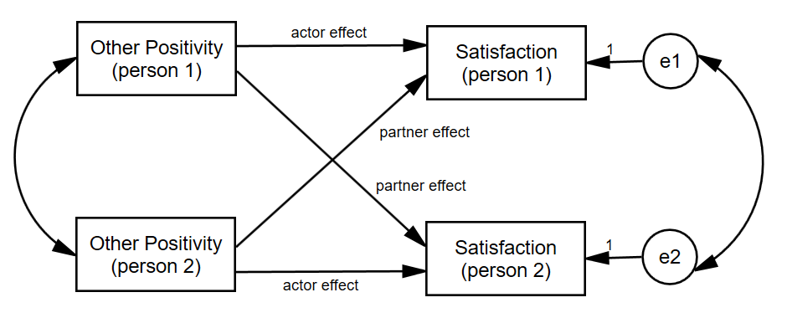
Example: APIM with Indistinguishable Dyads

Slide 57
R Demo

Slide 58
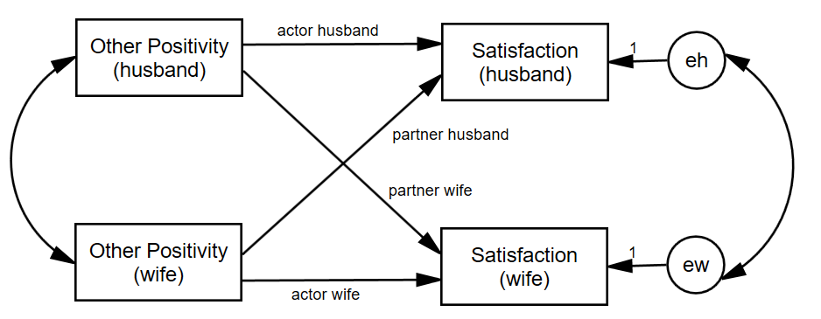
Example: APIM with Distinguishable Dyads

Slide 59
R Demo

Slide 60
Test of Distinguishability
Advantages of Treating Dyad Members as Indistinguishable
Simpler model with fewer parameters
More power in tests of actor and partner effects
Disadvantages of Treating Dyad Members as Indistinguishable
If distinguishability makes a difference, then the model is wrong.
Sometimes the focus is on distinguishing variable and it is lost.
Some editors or reviewer will not allow you to do it.

Slide 61
Test of Distinguishability
Four ways that dyads can be distinguishable
Intercepts (main effect of distinguishing variable)
Actor effects
Partner effects
Error variances

Slide 62
Test of Distinguishability
Two runs:
Distinguishable (either interaction or two-intercept, results are the same)
Different Actor and Partner Effects
Main Effect of Distinguishing Factor
Heterogeneity of Variance (CSH)
Indistinguishable (4 fewer parameters)
Same Actor and Partner Effects
No Main Effect of Distinguishing Factor
Homogeneity of Variance (CSR)

Slide 63
Test of Distinguishability
Run using ML, not REML
Note the number of parameters
There should be 4 more than for the distinguishable run.
Note the -2LogLikelihood (deviance)
Subtract the deviances and number of parameters to get a χ² with 4df
Conclusion: If χ² is not significant, then the data are consistent with the null hypothesis that the dyad members are indistinguishable. If however, χ² is significant, then the data are inconsistent with the null hypothesis that the dyad members are indistinguishable (i.e., dyad members are distinguishable in some way).

Slide 64
R Demo

Slide 65
Dichotomous and Small Count Response variables

Slide 66
(Quick) Logistic Regression Review
DV is dichotomous
probability of belonging to group 1 = P1, and the probability of belonging to group 0: P0 = 1 - P1.

Slide 67
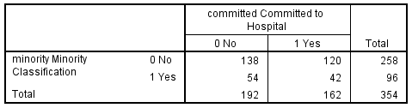
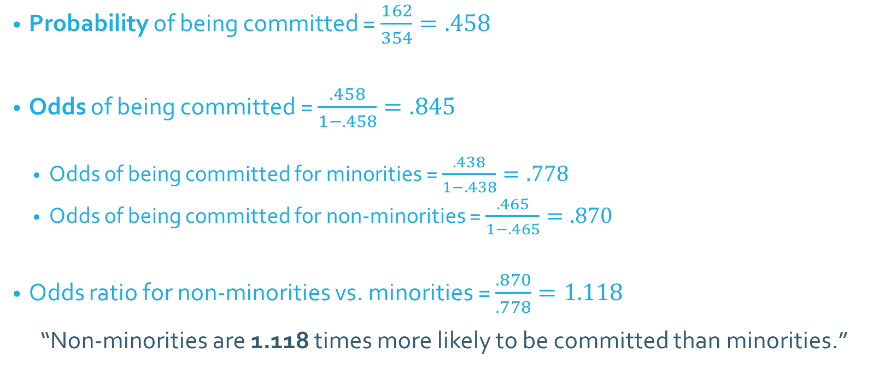
Odds and Odds Ratios
Probability of being committed = $\frac{162}{354}=.458$
Odds of being committed = $\frac{.458}{1−.458}=.845$
Odds of being committed for minorities = $\frac{.438}{1−.438}=.778$
Odds of being committed for non-minorities = $\frac{.465}{1−.465}=.870$
Odds ratio for non-minorities vs. minorities = $\frac{.870}{.778}=1.118$
“Non-minorities are 1.118 times more likely to be committed than minorities.”

Slide 68
Terminology
Odds –the odds of membership in the target group are equal to the probability of membership in the target group divided by the probability of membership in the other group.
Odds ratio – estimates the change in the odds of membership in the target group for a one-unit increase in the predictor.
computed by using the regression coefficient (b) of the predictor variable as the exponent of e.

Slide 69

Logistic Regression Equation
$$\ln\left(\frac{\hat{P_{1}}}{1−\hat{P_{1}}}\right)=b_{0}+b_{1}X_{1}+b_{2}X_{2}+…+b_{n}X_{n}$$
Where $\hat{P_{1}}$ is the predicted probability of being in group coded as 1
$\frac{\hat{P_{1}}}{1−\hat{P_{1}}}$ is the odds of being in group 1
$\ln\left(\frac{\hat{P_{1}}}{1−\hat{P_{1}}}\right)$ is the “logit” function

Slide 70
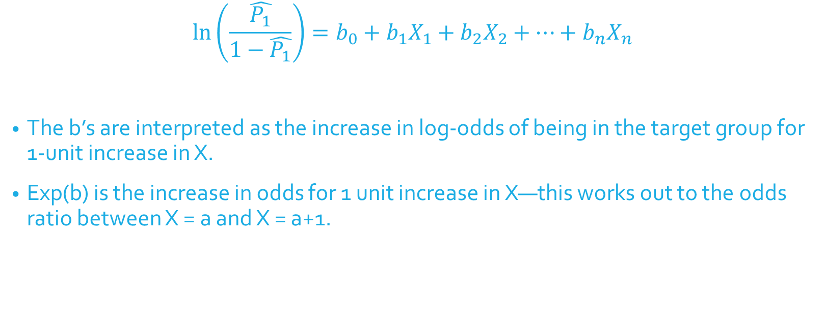
Logistic Regression Equation
$$\ln\left(\frac{\hat{P_{1}}}{1−\hat{P_{1}}}\right)=b_{0}+b_{1}X_{1}+b_{2}X_{2}+…+b_{n}X_{n}$$
The b’s are interpreted as the increase in log-odds of being in the target group for 1-unit increase in X.
Exp(b) is the increase in odds for 1 unit increase in X—this works out to the odds ratio between X = a and X = a+1.

Slide 71
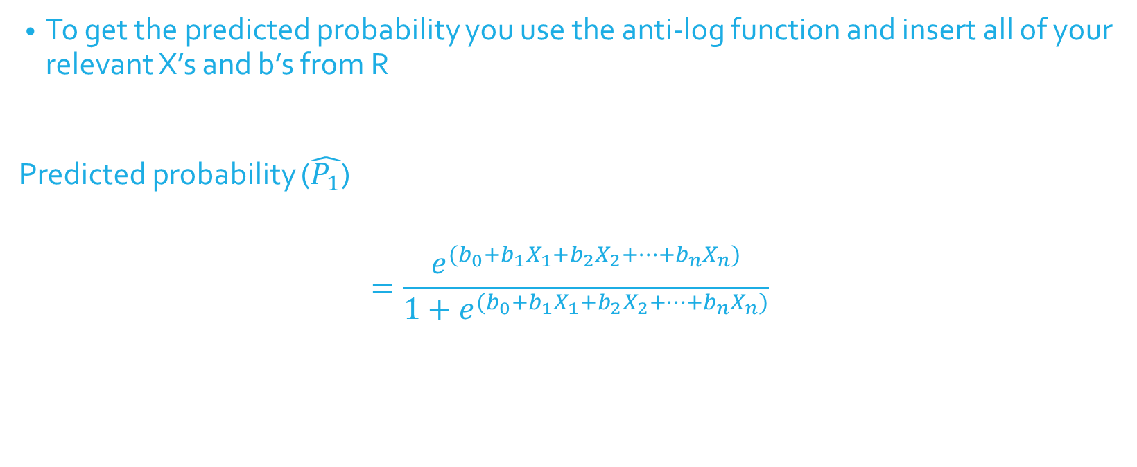
Logistic Regression Equation
To get the predicted probability you use the anti-log function and insert all of your relevant X’s and b’s from R
Predicted probability ($\hat{P_{1}}$)
$$=\frac{e^{(b_{0}+b_{1}X_{1}+b_{2}X_{2}+…+b_{n}X_{n})}}{1+e^{(b_{0}+b_{1}X_{1}+b_{2}X_{2}+…+b_{n}X_{n})}}$$

Slide 72
Generalized Estimating Equations (GEE)
Nonindependence treated as a “nuisance” to be removed; no statistical tests of nonindependence
Can be extended to:
Binomial outcome
Dichotomous (yes/no; pass/fail)
e.g., Own study habits and partner study habits as predictors of passing a test (yes/no)
Multinomial outcome
Categories (home/work/leisure)
Count data (Poisson, negative binomial)
e.g., Own stress and partner stress as predictors of number of days per month drinking alcohol
Can also be used for continuous outcomes (normal distribution)

